Slide 1
Let the Machine Beat the Analyst
Team 2475
Sophia Duong, Emerson Harkin, Xin Wang

Slide 2

“The manufacturing industry declined 1.9% to $197.5 billion in October, the third consecutive decrease.”

Slide 3
“The [industry name] industry [direction of change] [rate of change] to [value] in [current period], the [trend length] consecutive [direction of change].”
“The manufacturing industry declined 1.9% to $197.5 billion in October, the third consecutive decrease.”

Slide 4
What’s the growth rate this month?
What has the growth rate been historically?
Is there a significant difference?
Is it ‘surprising’?

Slide 5
“The manufacturing industry declined 1.9% to $197.5 billion in October, the third consecutive decrease.”
“The manufacturing industry was down for the third consecutive month, falling 1.9% to $197.5 billion in October.”

Slide 6
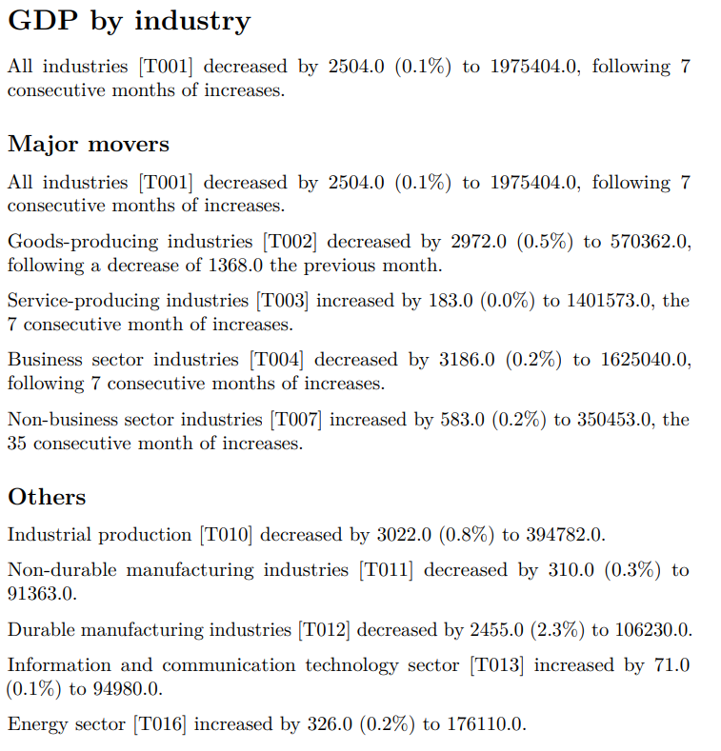
Pull dataset from StatsCan website
Clean the data

Slide 7
Template NLG
More tailored to content
Simpler to implement
Machine Learning NLG
More flexibility
More variance
Still improving

